Slide 1
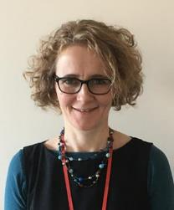
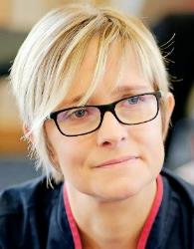
Welcome to our third virtual Update for Referrers
Hosted by:
9th June 2021
Dr Sarah MacLaran
Medical Director & Consultant in Palliative Medicine
Olivia Bowskill
Community
Engagement Manager

Slide 2
Overview
Inpatient Services
Outpatient Services
Myton Online Resources
Time for Q&A

Slide 3
Inpatient Services

Slide 4
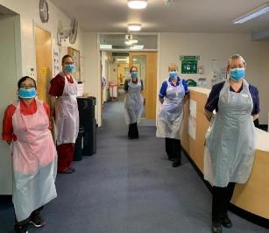
Inpatients
Both inpatient units open:
12 beds in Coventry
12 beds in Warwick
Referral Reasons:
Symptom Control – physical, spiritual and psychological needs
Terminal Care – days to weeks

Slide 5
Inpatient referrals
Hospital referrals require a pre-admission COVID-19 test prior to transfer
Community referrals do not require a pre-admission COVID-19 test – we will do this during our clerking
Patients with symptoms of COVID-19 or a positive test will only be offered a bed at Coventry Myton Hospice
At the current time we are unable to accept patients requiring Aerosol Generating Procedures (AGPs) into either Inpatient Unit (IPU)

Slide 6
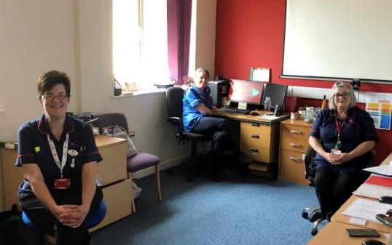
Inpatient referrals
Referrals Team cover Mon to Thurs 8am – 6pm
Friday 8am – 5pm
(excluding bank holidays)
Out of Hours via IPU nurse in charge
Online referral form
Call us - especially if urgent
Referrals and Discharge Team
01926 838889

Slide 7
Visiting on our Inpatient Units (since the 26th of May 2021)
A maximum of six nominated visitors per patient stay
Only 2 visitors are able to visit at any one time
All visitors are required to undertake home LFT’s
All visitors must follow strict guidance in relation to wearing PPE, handwashing and socially distancing
If a nominated visitor becomes symptomatic or confirmed with COVID-19 they will no longer be able to visit
For patients who are rapidly deteriorating or in the last hours/days of life:
The ward manager and/or senior nurse, will use their discretion to support the patients loved ones with their visiting needs.

Slide 8
Outpatient Services

Slide 9
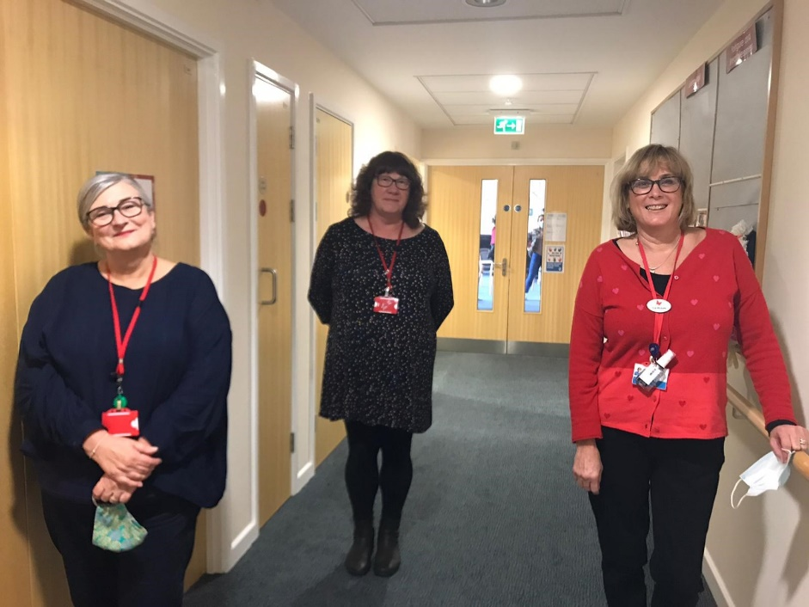
Patient and Carer Wellbeing Services
Supporting adults to improve wellbeing and quality of life whatever stages of their Palliative Care diagnosis.
Provide a range of activities to suit individual needs and abilities – which include face to face and virtual events.
MDT Support:
Promote self management of their condition
Themed social engagement activities
Provide education and information sessions
Advance Care Planning (ACP)
Signposting

Slide 10
Patient and Carer Wellbeing Services…contd.
Facilitate access to our Living Well programme - one to one, bespoke planned course of outpatient appointments.
- to enable individuals to identify and manage their most significant concerns and priorities.
- Examples of types of support: managing anxiety & fatigue,
strengthening emotional coping strategies etc.
Self Referral by telephone.
- Tel: 01926 838889 (9:30hrs to 13:30hrs) Mon - Fri
Health Care Professional can refer online www.mytonhospice.org/refer
Call our Wellbeing nurses on 02476 936786

Slide 11
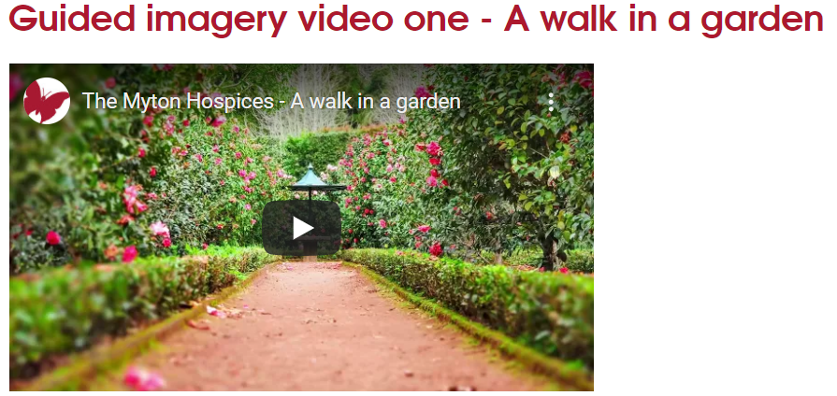
Example of Patient and Carer Wellbeing Online and Virtual Support

Slide 12
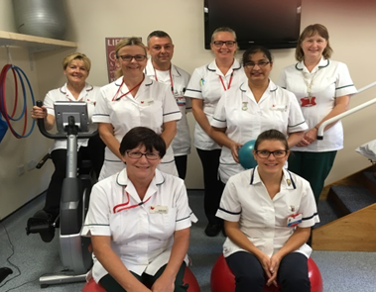
Fatigue and Breathlessness (FAB )
Patients with a life-limiting condition
Breathlessness is a core symptom, but who may also suffer from fatigue and/or anxiety
MRC Dyspnoea Scale: 3+
Techniques in managing breathlessness and fatigue
• Increase resilience and build coping strategies
Not for patients purely with Asthma
1:1 programmes delivered remotely via Telephone/Teams/
Plan: Re-introducing small face to face group work.
Online Referral Form for HCPs www.mytonhospice.org/refer
Call our FAB team on 01926 492518

Slide 13
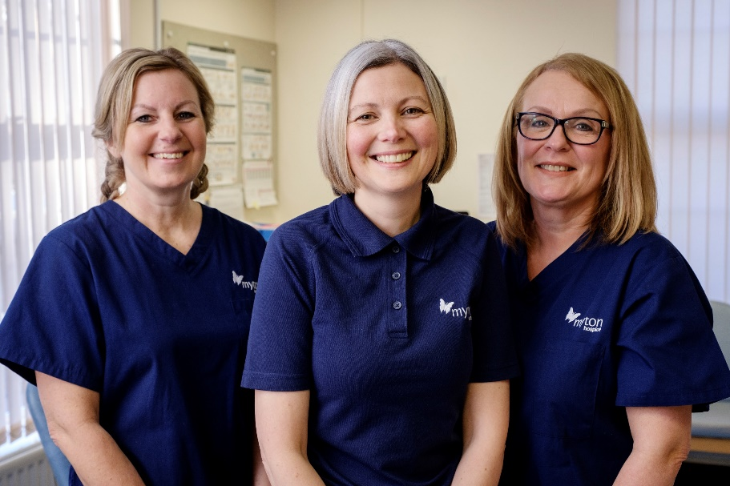
Lymphoedema
Related to active Cancer or Cancer treatment
Warwick & Coventry based clinics (Mon – Fri)
During pandemic remote assessment - Telephone/video/face to face - if essential
Online referral form or nhs.net email swg-tr.lymphoedema.myton@nhs.net
Call our Lymphoedema nurses on 01926 838806

Slide 14
Myton @ Home
Rugby, Leamington and Warwick
Service: 7 days a week
HCA support for patients and loved ones
Currently trialling a Clinical Nurse Practitioner role
Last 6 weeks and days of life
CHC fast tracking needs to be in place
Refer online www.mytonhospice.org/refer
Call our Myton at Home nurses on
Rugby: 01788 551516
Warwick: 01926 838814
Notes:
.

Slide 15
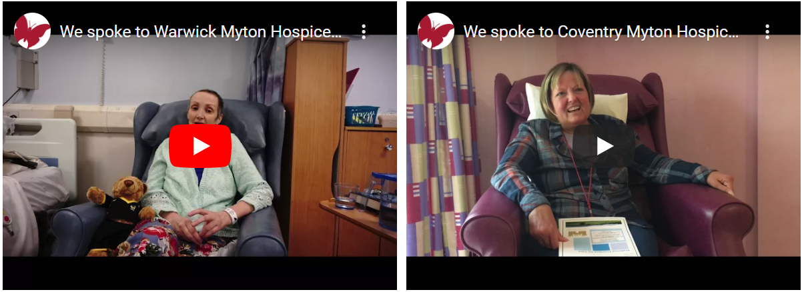
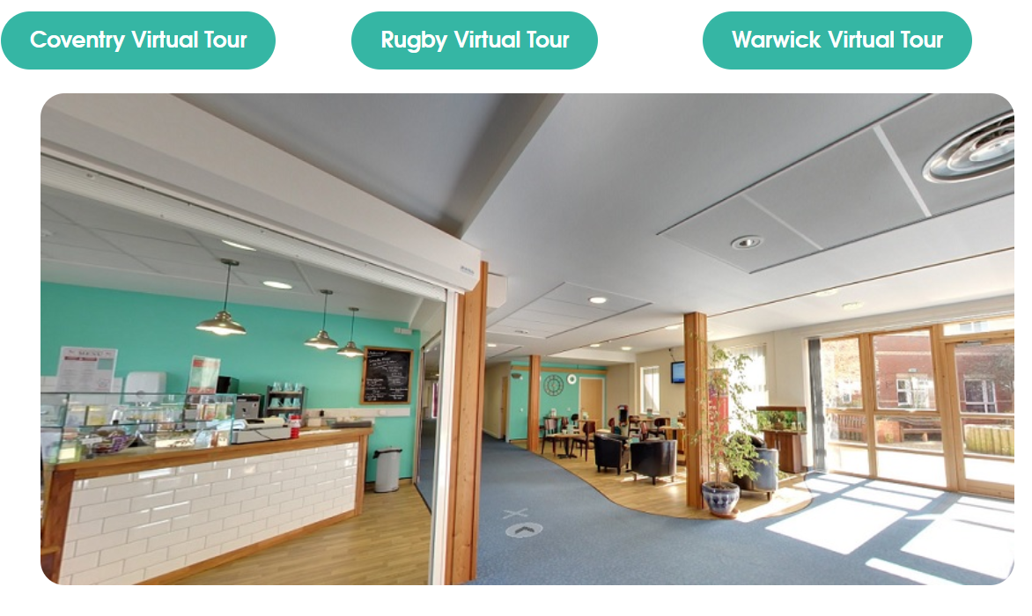
Useful Resources: www.mytonhospice.org
www.mytonhospice.org/healthcare-professionals
www.mytonhospice.org/videos
www.mytonhospice.org/virtualtour
www.mytonhospice.org/healthcare-professionals
/

Slide 16
Take Away Messages
Early intervention and support for patients and loved ones is key – please refer
Phone us – to discuss any patients that you feel would benefit from our services
We will never ‘discharge’ a patient
Contact olivia.bowskill@mytonhospice.org if there are opportunities for us to work with you and your team
Online Referral and Telephone Referral
01926 838889
www.mytonhospice.org/refer

Slide 17
Thank You

