Slide 1
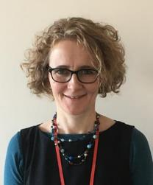
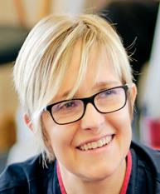
The Myton Hospices
Referrers Event
20th September 2023
Dr Sarah MacLaran – Medical Director and Consultant in Palliative Medicine
Olivia Bowskill – Community Engagement Manager (RN)
Q&A Panel:
Emma Morgan – Deputy Director of Nursing (Inpatient Services)
Jodie Morris – Deputy Director of Nursing (Outpatient Services)
Susan Fraser - Therapy Service Lead

Slide 2
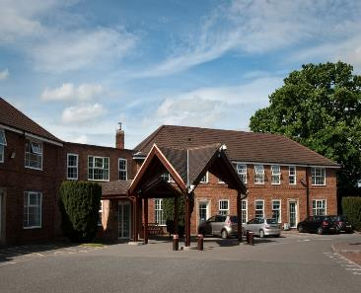
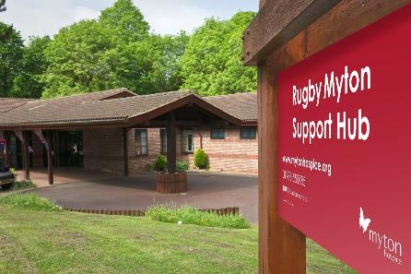
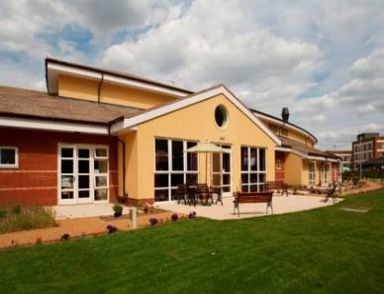
Our Hospices
Warwick Rugby Coventry

Slide 3
Who we care for…
‘We provide care and support for people aged 18+ living with a life-limiting illness in Coventry and Warwickshire.
We are not just about end of life care, we are here to support patients and their loved ones right from the moment they are diagnosed.’

Slide 4
Inpatient Services

Slide 5
MDT
Medical
Nursing
Complementary Therapy
Citizens Advice
Patient
Spiritual & pastoral Care
Physio
Counselling
OT

Slide 6
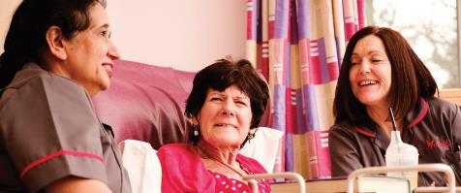
Inpatients (September 2023)
Inpatient units:
16 Coventry Myton Inpatient Unit
14 Warwick Myton Inpatient Unit
Referral Reasons:
Symptom Control – physical, spiritual and psychological needs
Terminal Care – days to weeks
Respite – scheduled and planned stay for 1 week, twice a year
(*Respite – currently at Warwick Myton Hospice)
8
Notes:
.

Slide 7
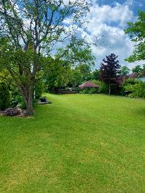
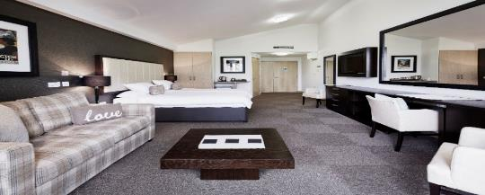
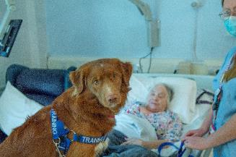
What can we offer?
All Patients rooms have access to our gardens.
Patients are able to have their pets (with clean paws!) visit.
Smoking room for patients
Family facilities: 2 flats at each site. quiet rooms, relatives able to order from our food menu

Slide 8
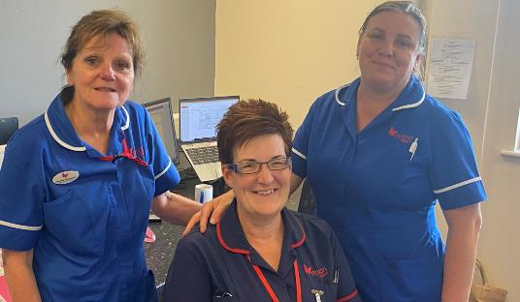
Inpatient referrals
Referrals Team cover Mon to Fri 8am – 6pm
(excluding bank holidays)
Out of Hours via IPU nurse in charge
Online referral form
Call us:
Referrals and Discharge Team
01926 838889

Slide 9
Measuring patient outcomes
From the 40% of our inpatients with severe or overwhelming pain upon admission,
85% report some improvement in their pain after their time at Myton…
50% of our inpatients have a major improvement, stating their pain is reduced to little or none.
Notes:
.

Slide 10
Outpatient Services

Slide 11
Patient and Carer Wellbeing Services
For adults to improve wellbeing & quality of life
Early proactive intervention
To live independently as possible in their own home and communities
Nurse led - F2F & 1to1, Telephone support
Small group work: Art and Crafts, Symptom Management, ACP
We will never discharge a patient from our services.
Self Referral by telephone. Tel: 01926 838889 (8am to 6pm) Mon - Fri
Health Care Professionals can refer online www.mytonhospice.org/refer
Call our Wellbeing nurses on 02476841923

Slide 12
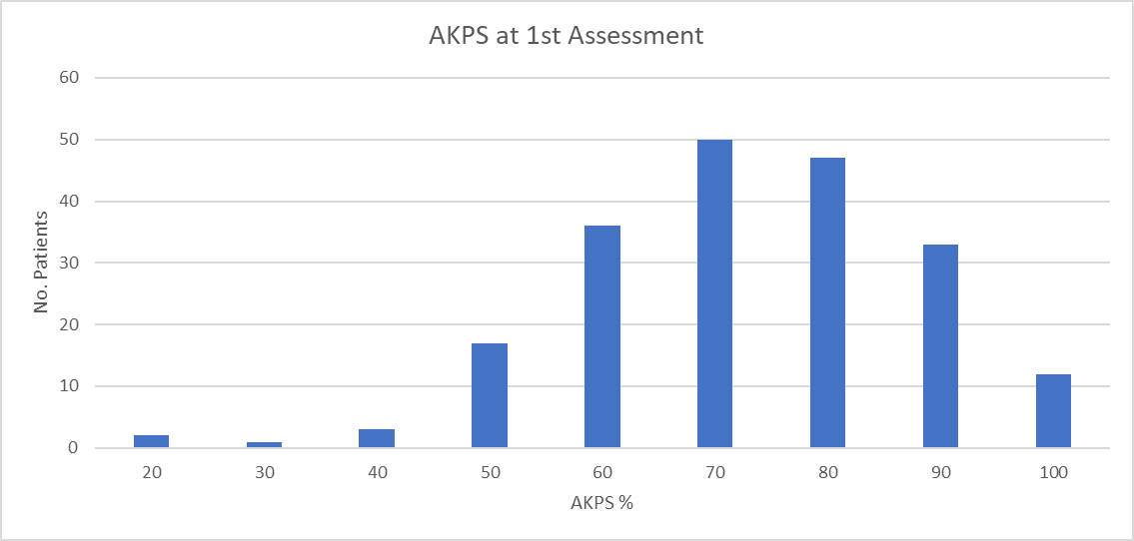
Referrals into Wellbeing Services
30% of all referrals are for patients who need assistance with day to day care
Less than half of all referrals are able to carry out normal activities
Notes:
.

Slide 13
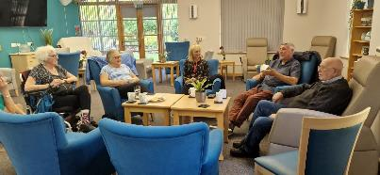
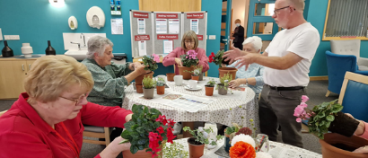
Rugby Myton Support Hub Sessions
TAB (Take a Breath)
Looking after you
Myton’s Time for me
The Listening Ear – Carers Support Group
*Carers Support Group will be coming to Myton’s Coventry & Warwick sites soon
PACE – (Practical Advice on Caring Every day for Yourself)
Coffee Connexion
Making Memories
Bereavement Help Point
Contact 01788 550085 between 9:30am and 4pm Mon to Fri

Slide 14
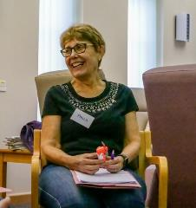
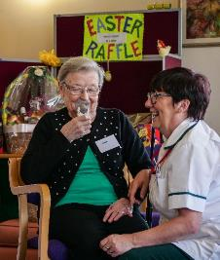
Fatigue and Breathlessness (FAB )
Patients with a life-limiting condition
Breathlessness is a core symptom, but who may also suffer from fatigue and/or anxiety
MRC Dyspnoea Scale: 3+
Not for patients purely with Asthma
Techniques in managing breathlessness and fatigue
• Increase resilience and build coping strategies
Small group work face to face
Online Referral Form for medical practitioners www.mytonhospice.org/refer
Call our FAB team on 02476841920

Slide 15
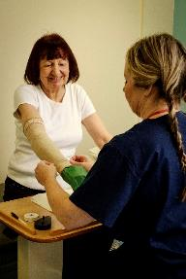
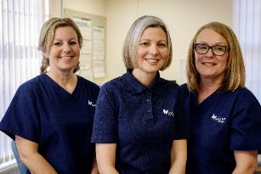
Lymphoedema
Secondary to active cancer and/or its past treatment
Clinics are run at both Coventry and Warwick Myton and a home visiting service is available for those who are housebound. (9-5pm Mon – Fri)
Face to face appointments and remote appointments depending on the patient’s needs
Online referral form or nhs.net email swg-tr.lymphoedema.myton@nhs.net
Call our Lymphoedema nurses on 01926838806

Slide 16
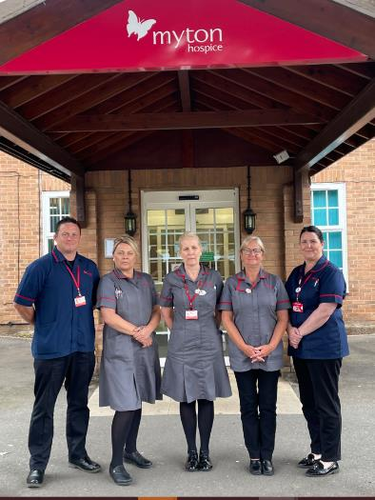
Myton @ Home
Rugby, Leamington and Warwick
Service: 7 days a week
HCA & Clinical Nurse Practitioner
Home support: 6 weeks and days of life
CHC fast tracking needs to be in place
Introduced self-referral to the service
If you would like to make a referral please call: 01788 550085
between the hours of 8.30am-4.30pm (Mon –Fri)
Outside of these hours please call the Myton at Home team directly on:
Rugby Team - 01788 551516
Warwick/Leamington Team - 01926 838814
Notes:
.

Slide 17
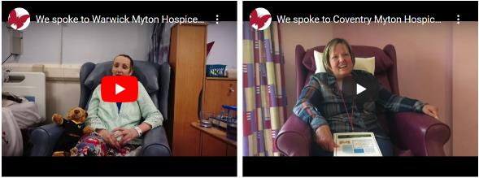
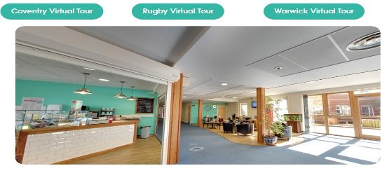
Useful Resources: www.mytonhospice.org
www.mytonhospice.org/healthcare-professionals
www.mytonhospice.org/videos
www.mytonhospice.org/virtualtour
www.mytonhospice.org/healthcare-professionals

Slide 18
Take Away Messages
Early referral to The Myton Hospices support –
Can improve a patients experience: quality of life, improve EofLC outcomes and Carers outcomes
We will never ‘discharge’ a patient
Online Referral and Telephone Referral:
01926 838889 / www.mytonhospice.org/refer
Regular updates:
www.mytonhospice.org/healthcare-professionals/

Slide 19
We appreciate your opinion?
https://www.surveymonkey.co.uk/r/ZCFBN78

Slide 20
Q&A
Thank you.

